Slide 1
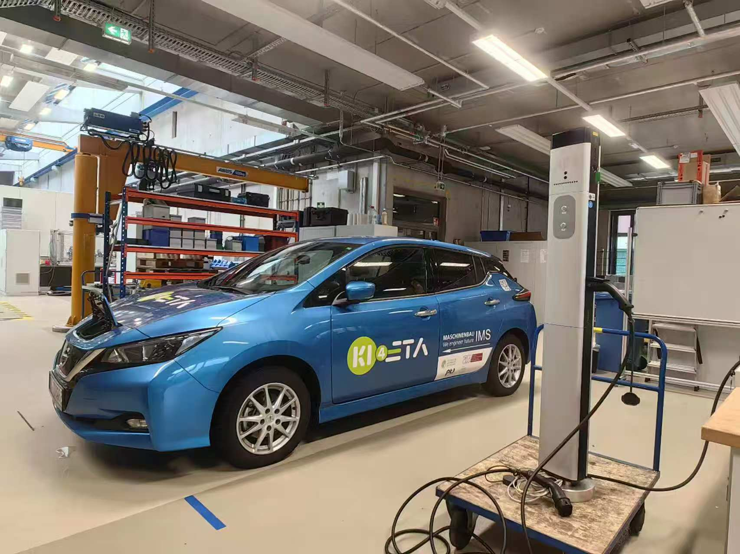
ADP - Charging Station Upgrade to OCPP Communication for Smart Charging
reported by Junfan Jin, Can Zeng, Yunan Jiang and Huang Chen

Slide 2
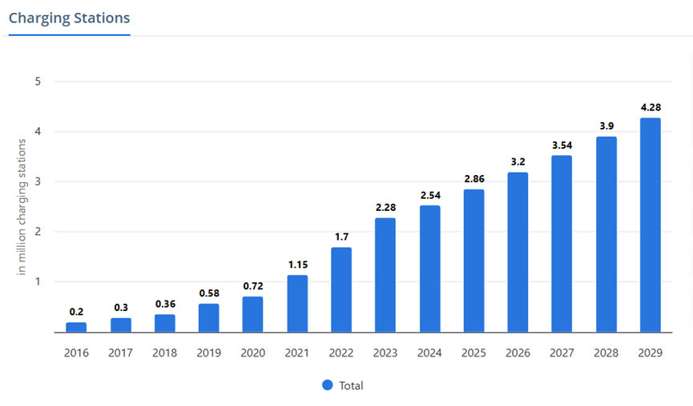
Background
1, Increasing number of
EVs & Charging Stations
2, In Germany, “plug and
charge” mode of 10 million
EVs by 2035 increase 50%
in low-voltage grid and
transformer costs [1]
Figure 1: Charge station sales increasing over the years [2]

Slide 3
Significance
OCPP
Peak shaving
Variable charging rate
Open source
Decrease overload of grid
Electricity price
Battery capacity

Slide 4
Objectives
1, Search and read existing literature on standardized charging infrastructure and smart charging
2, Learn about the existing charge point
3, Upgrade the old charge point
to support the OCPP communication protocol
4, Complete the construction of a prototype of a smart charging system
5, Test and debug the functions of the smart charge point

Slide 5

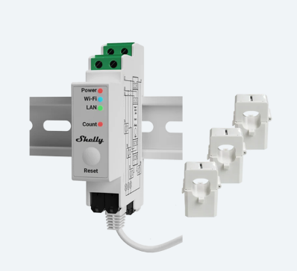
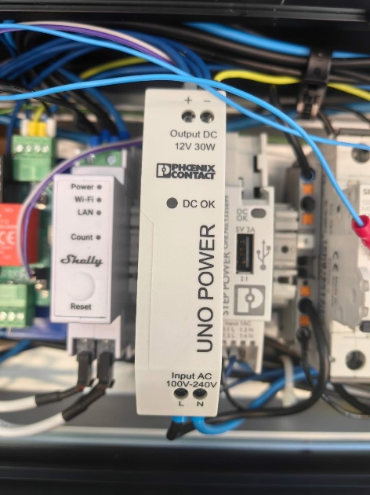
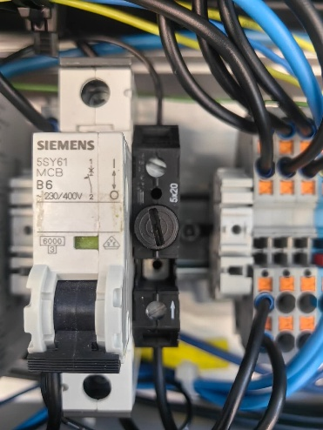
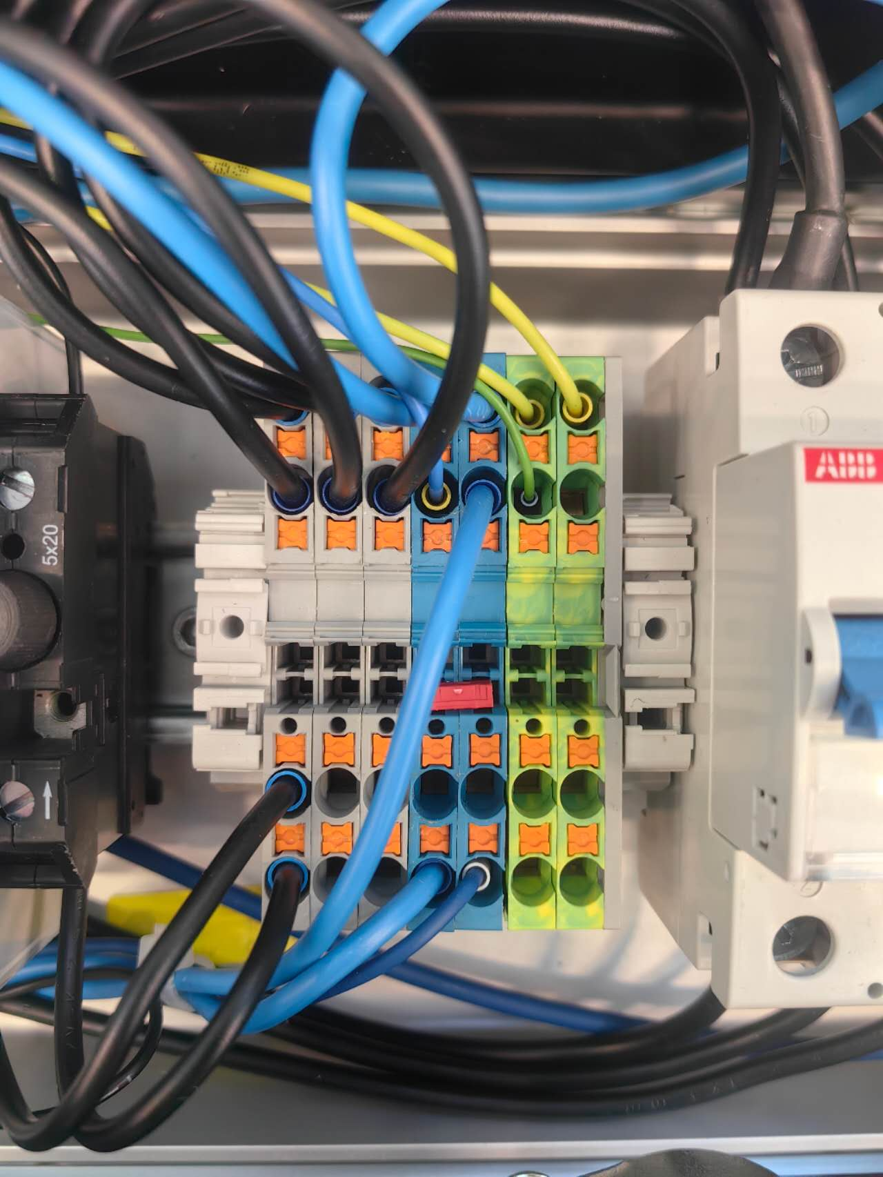
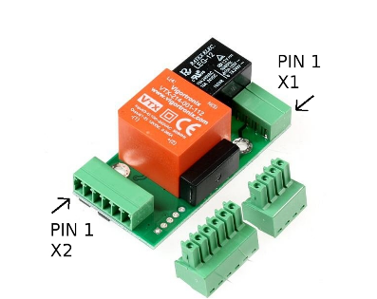
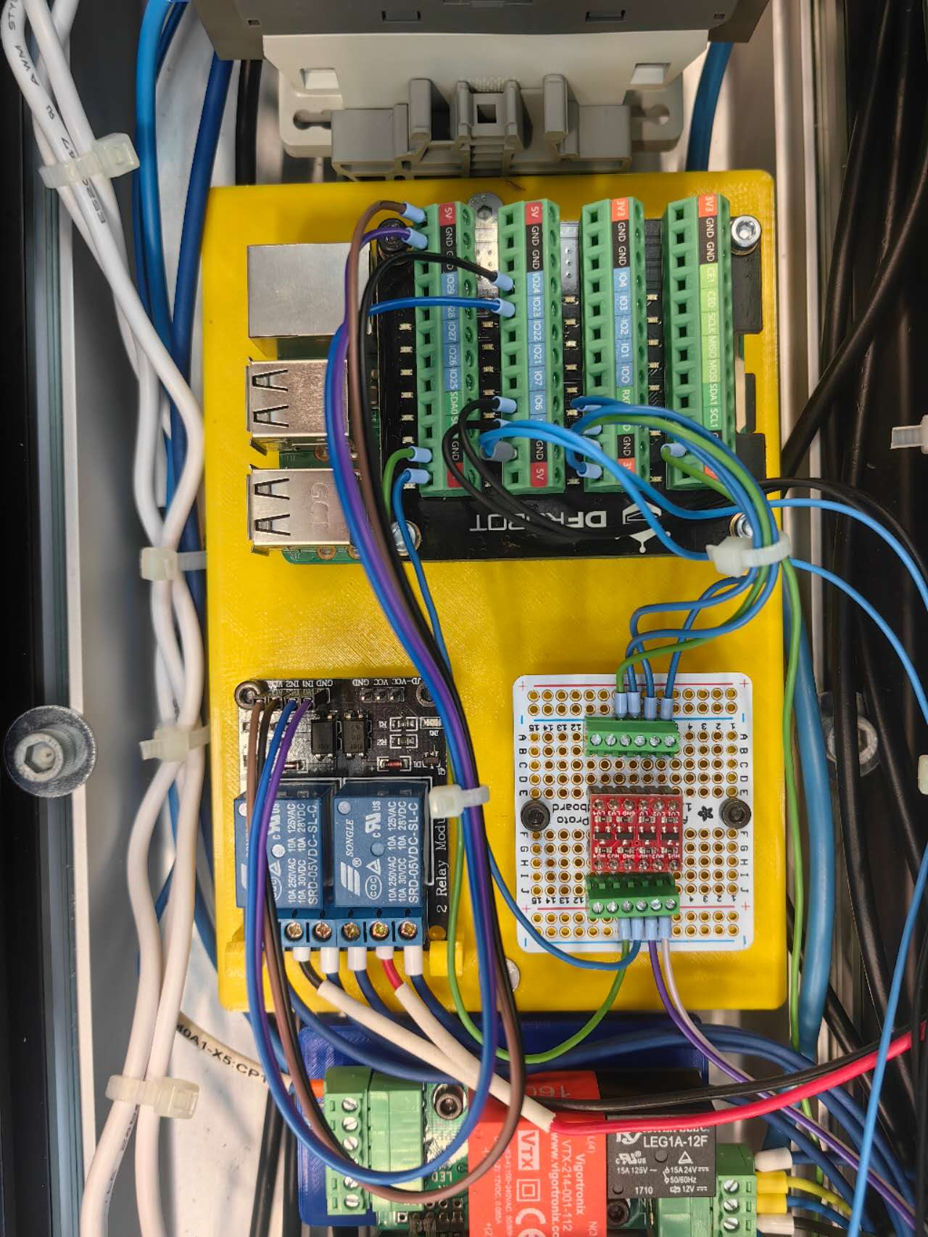
Hardware
Shelly sensor
Power supply, Circuit breaker, Fuse, Wire connector, etc.
EVSE
SmartCharge Board
Auxiliaries
Original charge station
Main functional components
Notes:
Our charging station is mainly composed of these parts

Slide 6
Main functional components
Shelly sensor
Shelly Pro 3EM
3 current clamps measure the 3-phase current: used for Data Visualization.
Record total charged energy: used for the Calibration of the charge plan.
EVSE
Electric Vehicle Supply Equipment
Communicate with EV in the form of PWM signal and voltage level, indicating the maximal allowed current and vehicle state.
Controlled by reading/writing the corresponding registers via Modbus communication
Notes:
The main functional components include a shelly sensor. This sensor can measure the current of each phase of the 3-phase power and provide data for our system.
EVSE stands for Electric Vehicle Supply Equipment. The duty cycle of PWM signal indicates the allowed current. The voltage level describes the vehicle state like whether the EV is ready or is in charging. Through Modbus communication, the system implements different functions by reading and writing different registers of EVSE.

Slide 7

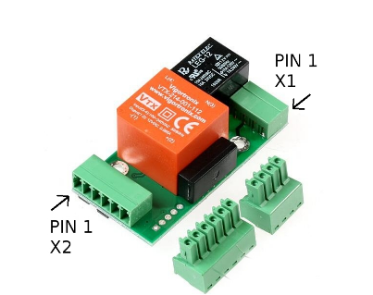
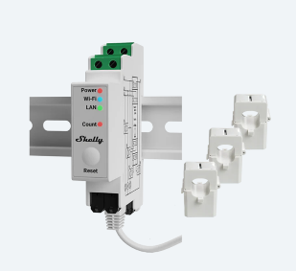
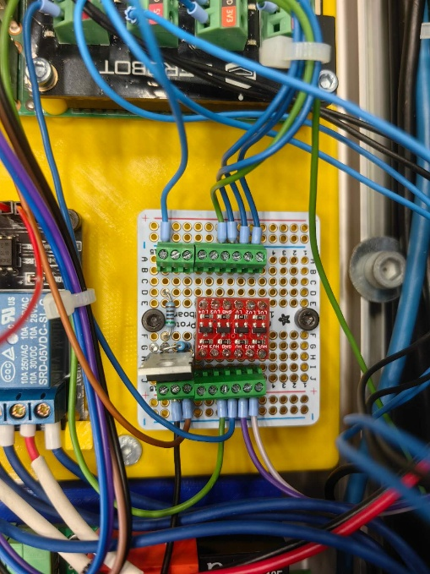
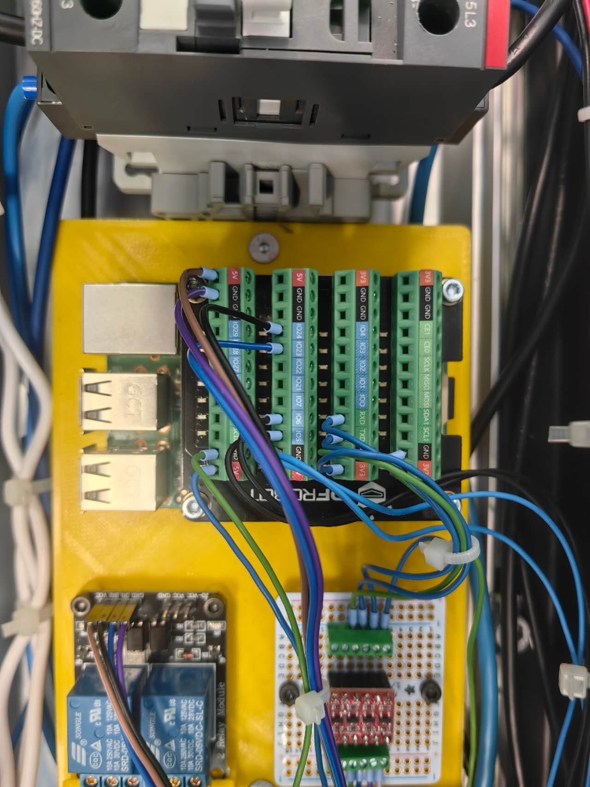

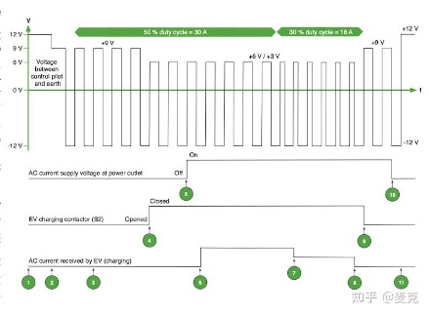

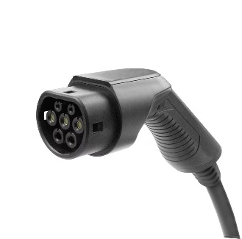
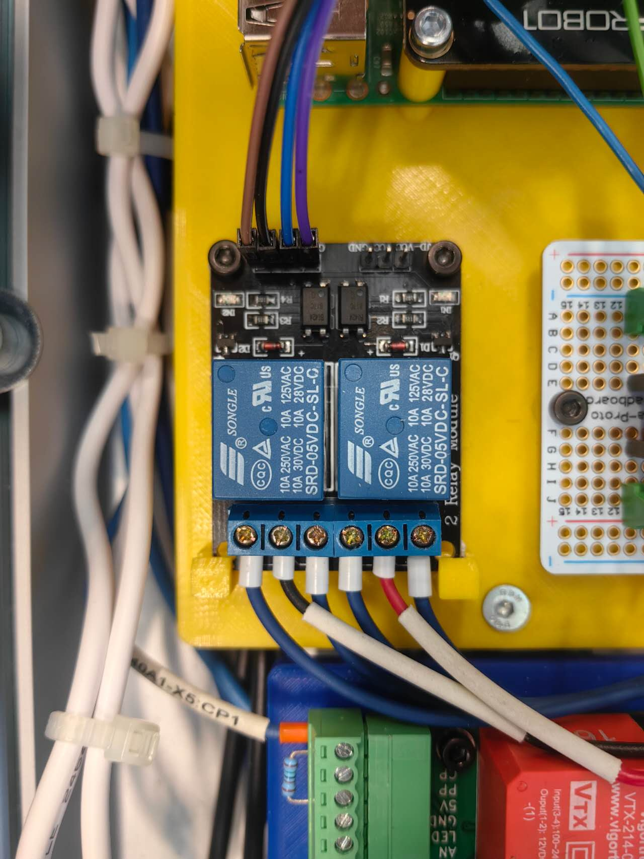
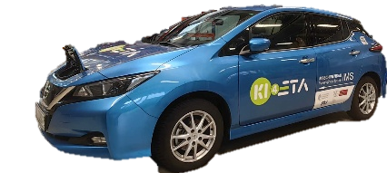
Main functional components
Server
3.5V
Level shifter
5V
EVSE
GPIO
HTTP request
Modbus
Shelly
Raspberry Pi
GPIO
LED
PWM signal
Latch motor
Relay
Notes:
The smart charge board is the most important part. It is a 3D-printed board to mount the Raspberry Pi, level shifter, and a dual channel relay.
Raspberry Pi is the carrier of the program. It is connected to the WiFi, which is provided by the Shelly sensor, and acquires the data with HTTP request.
As mentioned, the Raspberry Pi communicates with EVSE via Modbus communication. It is worth noting that the working voltage of these two parts is different. That is why we need a level-shifter in between. It prevents the Raspberry Pi from GPIO pin damage.
The EVSE communicates with the EV using PWM signal. We also used the GPIO pins of Raspberry Pi to control the latching and releasing of the charge plug by changing the rotary direction of the latch motor with a relay. We also manipulate the blinking of the LED light to indicate the charging state.

Slide 8
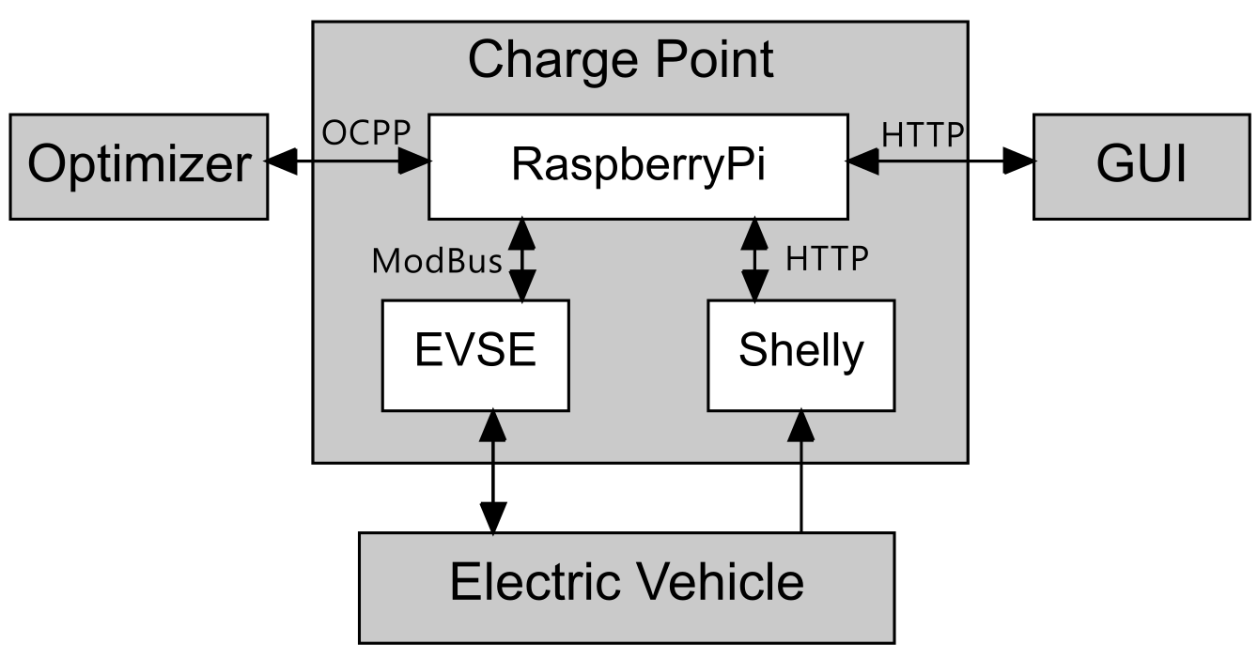
System Architecture Overview
Notes:
So I will introduce the system structure first.
This project has four main parts: the optimizer, the charging station, the vehicle, and the remote GUI control. Inside the charging station, we have the Raspberry Pi controller, the EVSE actuator, and the Shelly sensor.
For communication: the optimizer and Raspberry Pi communicate using the WebSocket protocol with OCPP. The GUI and Shelly communicate through HTTP, and the EVSE is controlled using the Modbus protocol.

Slide 9



System Architecture Requirements
Communication Protocol
Concurrent Tasks Scheduling
System Expansion
OCPP Protocol
WebSocket Communication
Message Management
GUI Control
Data Collection
Execution of Charging Logic
...
Multiple Charging Ports
Foundation of Database
...
Multiple Charging Ports
Foundation of Database
...
Notes:
We considered a few key technical points during the design:
First, the communication protocols, which must support WebSocket and OCPP;
Second, concurrent task scheduling, using coroutines and multithreading for tasks like message management, GUI control, real-time data collection, and charging logic;
And third, system expansion, with design considerations for future expansion.

Slide 10


System Architecture Implementation
Communication
Concurrent Tasks
Expansion
OCPP v2.0.1 Message (JSON)
Complex hierarchical nesting, difficult to learn structure
Frequent reference to the OCPP Standard is required when writing code
High probability of error, with significant debugging costs
Notes:
The first challenge is learning and using the OCPP protocol. The OCPP 2.0.1 message structure is complex, and there are many reference links in the standard document. Just like in this picture, it connects from one place to another, and then continues to another place. This means we often need to look up the standard. Writing the messages manually can also result in errors.

Slide 11


System Architecture
Implementation
Communication
Concurrent Tasks
Expansion
OCPP Message Generator
Use different generation functions
to generate each message part
IDE: Type annotation and Docstring
Easier to learn and use OCPP Message
Less errors
Notes:
To solve this, we designed a message generator. It works by passing parameters through functions to build the OCPP messages step by step like a production line. It can reduce errors and make it easier for developers to understand and use.

Slide 12


System Architecture
Implementation
Communication
Concurrent Tasks
Expansion
Problem
Multiple modules
complex calls
high coupling
Signal Class -- Decoupling
Supports synchronous/asynchronous calls
Lower coupling
More flexible than callback functions
Easier to expand
Func
Signal.emit
Func
Notes:
Because the system has many modules and complex function calls. So, we needed a way to reduce the coupling. we implemented a Signal class referencing the Qt Signal to decouple the system. We only need to connect functions to signals externally. When a signal is emitted, the function will be called. Compared to callback functions, this method is more flexible and has lower coupling.

Slide 13




System Architecture
Implementation
Communication
Concurrent Tasks
Expansion
System Expansion
Database Support: the foundation for Database
Support multiple charging ports for testing: dynamically add to the system
Modular Architecture Design: Easy to combine and expand
Multi-Platform GUI Control Support: Unified Control
Notes:
For system expansion, we created a data management class to handle all the data uniformly. This is a good foundation if we need to connect to a database in the future. We also thought about supporting multiple charging ports for testing, which can be dynamically added to the system. The modular design makes future expansion easier. Our GUI is web-based, but we also provide communication interfaces for desktop or mobile devices.

Slide 14
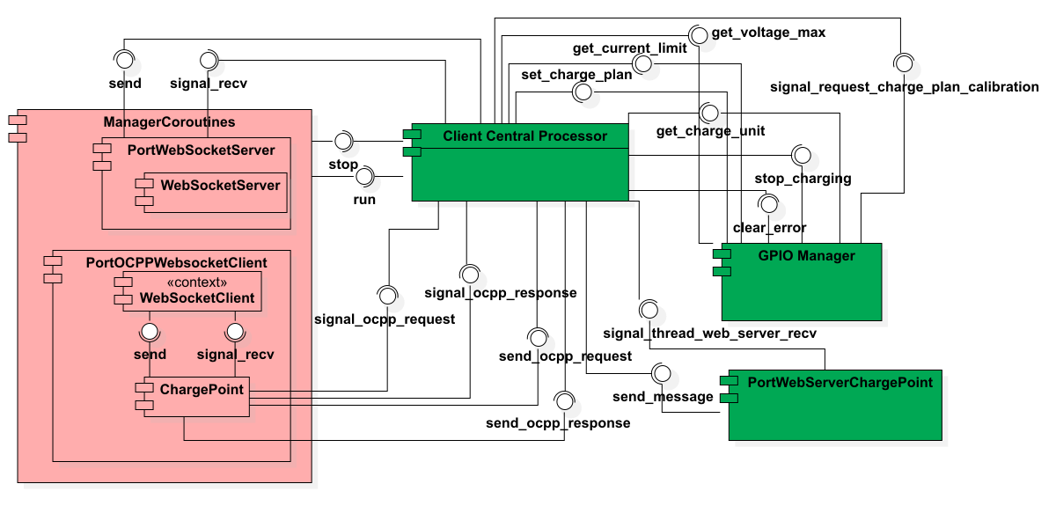
System Architecture
Charge Point
Notes:
This is the internal structure of the charging station. The pink parts are coroutines, and the green parts are threads. All modules connect to the Central Processor, which manages the scheduling.

Slide 15
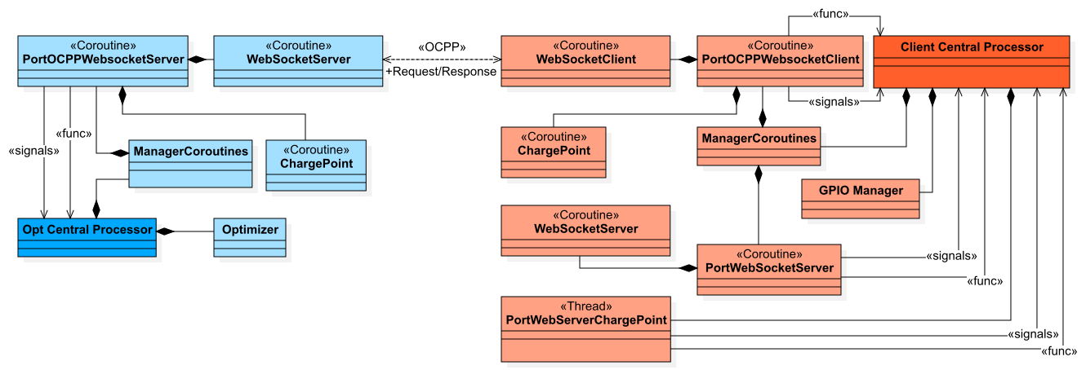
System Architecture
Project
Notes:
This is the overall system structure. On the left is the optimizer, and on the right is the charging station. They communicate through the OCPP protocol.
Next, Yunan will explain the charging logic part.

Slide 16



Charge modes
Direct charging
Manual schedule
Dynamic adjustment
Start
Stop
Buttons on the charge pile or website
Charge according to the uploaded schedule
Start time, power
The schedule is generated by the optimizer
Calibration of the charging plan periodically
Notes:
We have designed 3 charge modes.
Direct charging can literally only control the start and stop of charging, by pressing the buttons on the charge pile via the website. Then the charge station will charge at the maximum allowed current.
The Manual schedule mode is mainly used for debugging. The charging station will charge according to an uploaded schedule. The charge time point and charge power are defined in this schedule.
The dynamic adjustment mode is the main target of our project. It realizes the smart charging. The optimizer will generate the charging plan according to the user’s needs like “lowest electric price.” To compensate for the deviation in the charging process, the charge plan will be calibrated based on the data collected from our sensor.

Slide 17
Detailed charging steps
Plug in the charge plug
Select the charge mode and start
Before charging
In charging
Charging ends
EVSE:
EV is present
Check:
Vehicle,
EVSE,
Shelly, applicable plan
Latch plug
Optimizer generates the plan
Max. current to EVSE
Calibration
Polling-EVSE, Shelly
Unlatch
Clear data
If not
ERROR
Hardware failure
Notes:
At different stages of charging, our charging stations will perform different actions.
When the charge plug is inserted, the EVSE will change the value of the register, which indicates the state of the vehicle. Then the user will select the charge mode and press start. The system will check if all the components are working properly, and also check if the plan is applicable, for example, the user wants to fully charge the car in 5 minutes. It is impossible.
If everything is OK, the charge station will lock the charge plug, the Optimizer will generate the plan. The output power is controlled by changing the maximum current of EVSE. The system will periodically calibrate the plan, and get data from the EVSE and the Shelly sensor via polling. If any hardware failure occurred in this process, it will raises an error and the charging will be terminated.
After the charging is finished, the charge station will unlatch the charge plug and clear the data stored in Shelly.

Slide 18
Trim of plan
System response delay
Network delay
Charge
unit 1
1kW
2kW
1kW
2kW
Charge
unit 2
4kW
2kW
delay
4kW
2kW
Charge
unit 3
1kW
2kW
1kW
2kW
Limit
(6kW for example)
8kW
6kW
6kW
6kW
6kW
2kW
1st hour
2nd hour
1st hour
2nd hour
Notes:
In our project, we have considered a lot about the influence of delays. For example, according to the plan, three charge will charge without violating the limit of power. But due to the delay, the charge schedule of unit 2 arrived later than expected. Consequently, the total power exceeds to limitation for the same period of delay. This may cause equipment overload.

Slide 19

Trim of plan
Arrive of New schedule/
Schedule update
Now
New schedule start time is in future
Old schedule
New schedule
Time
Arrive of New schedule/
Schedule update
Now
Old schedule
New schedule after truncation
New schedule
Time
Cut off
New schedule start time already passed
Notes:
To solve this, the system will not directly execute the new schedule.
If the new schedule starts in the future, the system will wait or continue with old schedule.
If the new schedule start time is already passed, the system will cut the expired parts of the schedule, and continue with the rest parts.

Slide 20
Trim of plan
Before truncation
After truncation
Charge
unit 1
1kW
2kW
1kW
2kW
Charge
unit 2
delay
4kW
2kW
4kW
2kW
Charge
unit 3
1kW
2kW
1kW
2kW
Limit
(6kW for example)
8kW
6kW
6kW
6kW
6kW
2kW
2kW
1st hour
2nd hour
1st hour
2nd hour
Notes:
In this way, this problem is avoided and the deviation will be compensated by the following calibrated schedule.

Slide 21
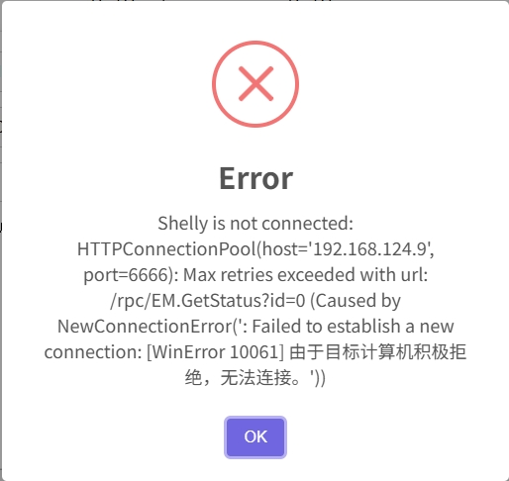
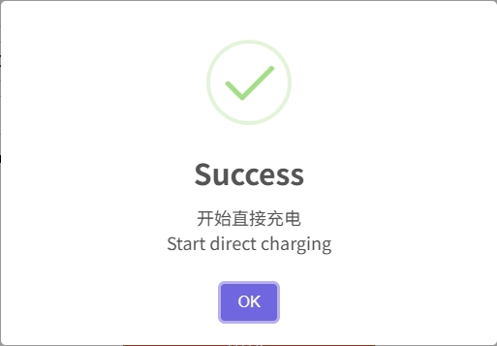
Observe the charging state
按钮图
LED light on the button
pop-up window
Notes:
In order to improve the human-machine interaction experience, apart from the pop-up window on the website, we also utilized the LED light embedded in the button. The blinking frequency of the LED indicates the current charging process.

Slide 22
Optimization method
Why Use scipy.optimize.minimize for Optimization?
Advantages:
Simple algorithm, easy to deploy
High computational efficiency for small-scale problems
No need for large datasets or training
High interpretability, transparent optimization process
Suitable for short-term scheduling or online optimization
Notes:
We ultimately chose to use scipy.optimize.minimize for our optimization task because it’s simple, efficient, and well-suited for small-scale, short-term problems. Unlike deep learning, it doesn’t require large datasets or a training phase, which makes it quick to deploy. Its optimization process is also highly interpretable—we can easily track the objective function values and gradients.
However, there are limitations. When dealing with multiple uncertainties—like price forecasts or user behavior—this method can get stuck in local optima. It also relies heavily on gradient information, which isn’t ideal for non-differentiable or non-smooth functions. Most importantly, it lacks the ability to learn from historical patterns, making it less suitable for long-term predictive optimization where deep learning excels.

Slide 23
Optimization considerations
Predict Charging Demand & Balance Grid Load → Consider with historical data, user patterns, weather, etc. → gene_his_usage() generates realistic usage history
Optimize Charging Costs Under Dynamic Pricing → Adjust charging strategy across time periods → gene_eprices() simulates day/night dynamic pricing
Address Diverse User Preferences → customData.mode supports 3 strategies: • Fast Charge (urgent needs) • Cost-Saving (low-price periods) • Balanced (time, cost, load)
Notes:
In this project, we addressed six major challenges in EV charging optimization.
First, to forecast future charging demand and balance the grid, we use historical usage data and dynamic scheduling algorithms. Our gene_his_usage() function simulates realistic consumption profiles, laying the foundation for intelligent decisions.
Second, for optimizing charging costs under dynamic electricity pricing, we employ predictive models. Our gene_eprices() method simulates price changes between day and night, helping the optimizer adjust for cost efficiency.
Third, we recognize users have different preferences. By extending the OCPP message with a mode field, we support three strategies: fast charging, cost-saving, and balanced.

Slide 24
Optimization considerations
4. Extend Battery Lifespan → Avoid deep discharge, high-rate charging → Intelligent post-full-charge trickle to reduce battery stress
5. Achieve Grid Load Balancing (V2G) → Leverage V2G to feed power back to the grid at peak times → V2G not implemented due to vehicle limitations
6. Improve User Experience → Analyze habits and history to suggest best time & location → Real-time station recommendations, navigation integration
→ Future plan: Develop mobile app for smart personalized charging
Notes:
Fourth, to protect battery health, our strategy includes continuing low-current charging after the battery is full, reducing degradation.
Fifth, although we explored V2G concepts for load balancing, this was not implemented due to vehicle limitations.
Lastly, we aim to enhance user experience through personalization. While this feature is not yet complete, we plan to develop a mobile app that suggests optimal charging locations and times based on user habits and real-time availability.
Together, these strategies form a smart, adaptable EV charging system focused on efficiency, user needs, and grid stability.

Slide 25
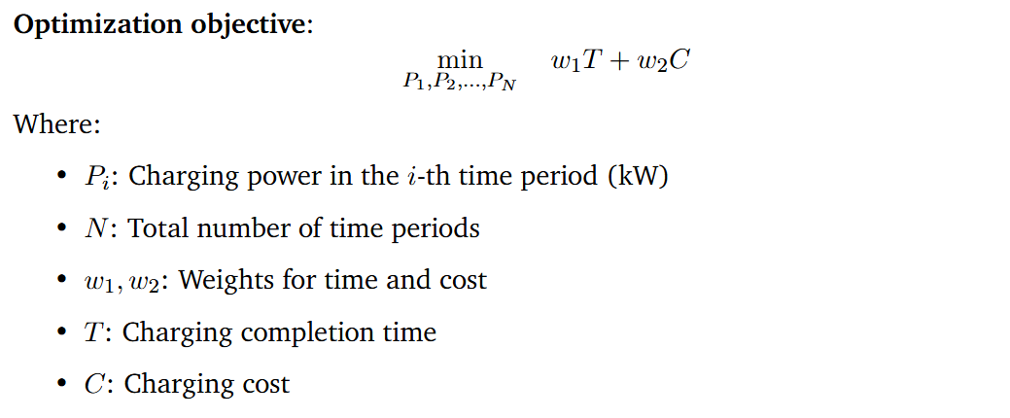
Optimization objective
Notes:
This is the core optimization objective of our charging strategy.
We aim to minimize a weighted sum of two key factors: the charging completion time T and the charging cost C.
The variables we optimize are the charging powers P1,P2,…,PNP_1, P_2, \dots, P_NP1​,P2​,…,PN​ across NNN time periods.
The weights w1w_1w1​ and w2w_2w2​ allow us to adjust the priority between speed and cost— for example, in fast charge mode, we assign a higher weight to time; in cost-saving mode, the cost term becomes more important.
This flexible formulation lets us tailor the strategy based on user preferences or grid conditions.

Slide 26
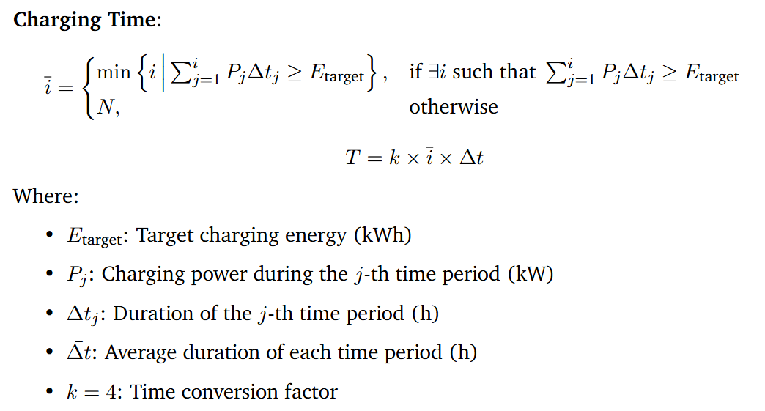
Optimization objective
Notes:
This equation defines how we calculate the charging time required to reach the energy target.
First, we identify the earliest time index i‾\overline{i}i at which the accumulated energy from charging—calculated as the sum of PjΔtjP_j \Delta t_jPj​Δtj​—meets or exceeds the target energy EtargetE_{\text{target}}Etarget​.
If the target is never met, we assume the full schedule is used.
Then, we compute the total charging time Tby multiplying i‾\overline{i}i with the average time step Δtˉ\bar{\Delta t}Δtˉ and a factor k, which adjusts the time units to match our system output—such as converting hours to time slots or cost units.
This approach allows us to evaluate and minimize charging duration as part of the overall optimization.

Slide 27
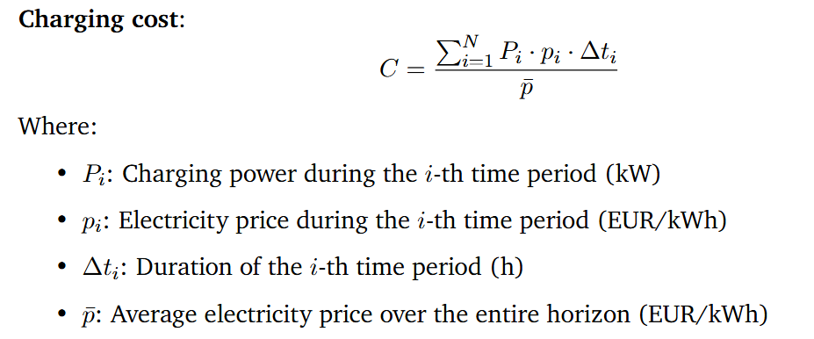
Optimization objective
Notes:
This equation defines the charging cost CCC as a normalized sum of energy consumption over time.
In each time period iii, the cost is calculated as the product of the charging power PiP_iPi​, the electricity price pip_ipi​, and the duration Δti\Delta t_iΔti​.
We then sum this over all time periods and normalize it by the average electricity price pˉ\bar{p}pˉ​.
This normalization allows us to compare cost-effectiveness under different pricing conditions and ensures the cost term is consistent with other terms in the objective function.
By optimizing this term, the system prefers charging during low-price periods while still ensuring the energy demand is met efficiently.

Slide 28


Optimization objective
Notes:
To ensure feasibility and safety, our optimization includes two key constraints.
First, the total charged energy—the sum of Pi⋅ΔtiP_i \cdot \Delta t_iPi​⋅Δti​ over all time periods—must meet or exceed the target energy EtargetE_{\text{target}}Etarget​.
Second, in each time period, the charging power PiP_iPi​ must stay within its allowed range, defined by a minimum and maximum power limit, Pmin⁡,iP_{\min, i}Pmin,i​ and Pmax⁡,iP_{\max, i}Pmax,i​. These bounds can vary depending on hardware limits or grid constraints.
For the initial guess used by the optimizer, we simply set P0P_0P0​ as the average of all maximum powers across the time horizon.
This initialization provides a reasonable starting point for the solver to quickly converge to an efficient solution.

Slide 29
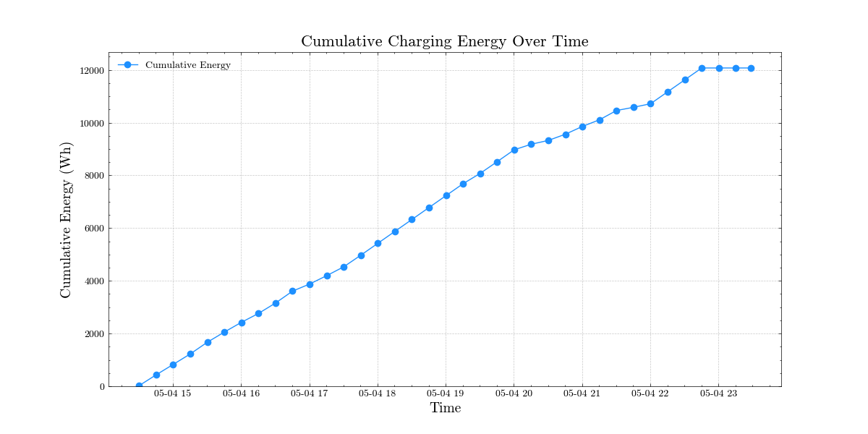
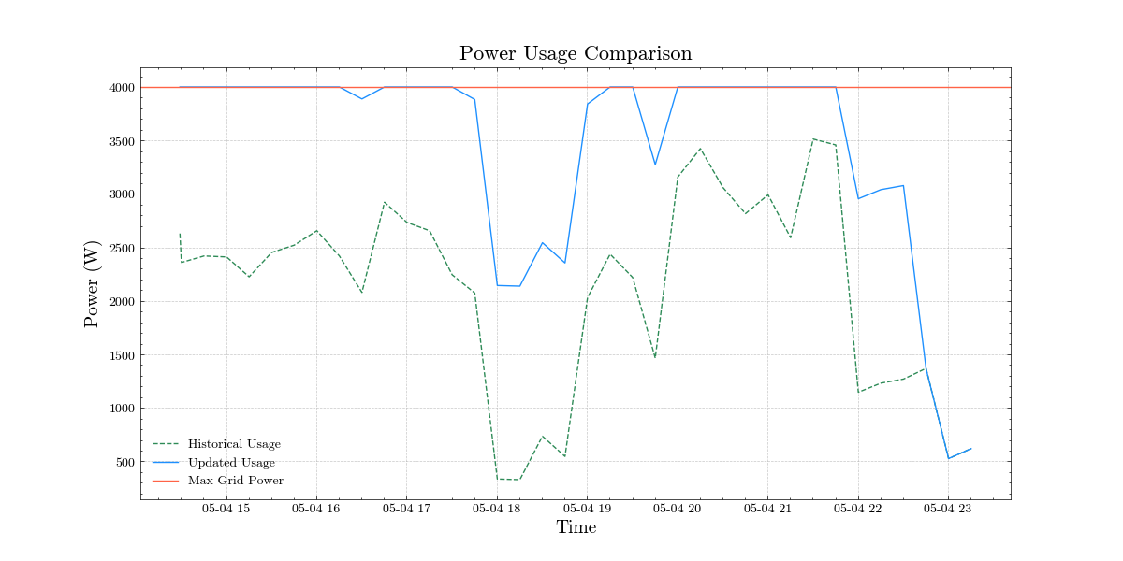
Optimization result

Slide 30
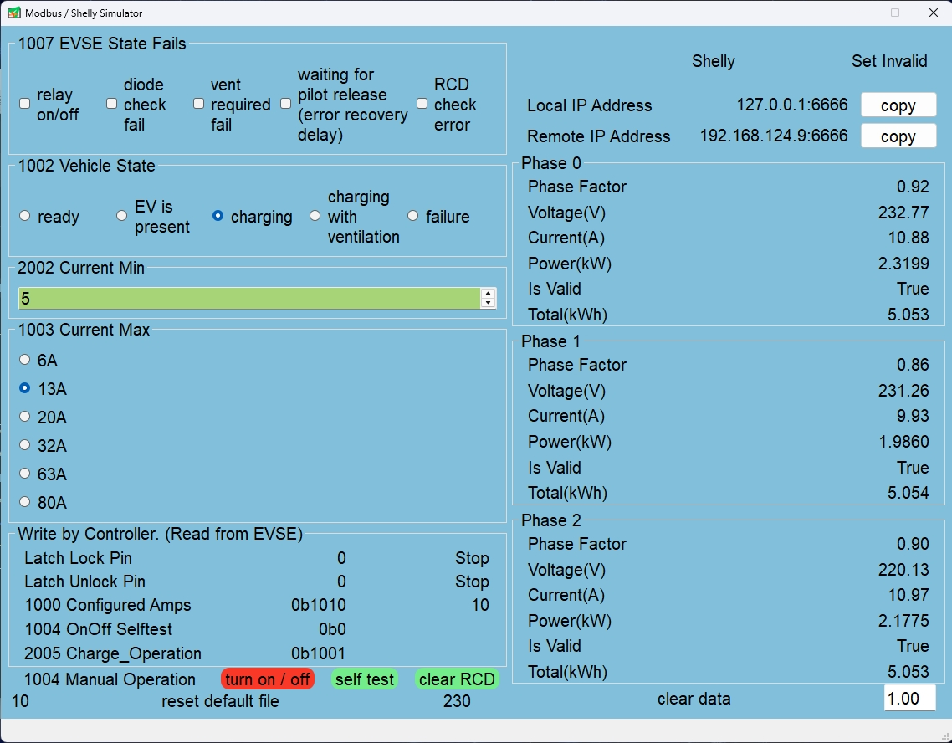
Simulation
EVSE & Shelly Simulator
Notes:
We wrote a software to simulate the reading and writing of evse and shelly, which is convenient for debugging algorithms without hardware.
The simulator is developed using PyQt5 and provides a visual interface, allowing users to view and adjust simulation parameters.
This simulator allows for the debugging and optimization of the system’s charging control logic in a safe testing environment, ensuring functionality correctness and reducing the safety risks associated with direct live testing.

Slide 31

Problems during Testing
1, No indicator for charge point
Solution: LED for the Start button
lit – charge point ready to
set current
blinking – Charging beginns
2, Modbus port allows only one thread at
one time
Solution: first, serialize access using thread
lock (use context manager to
manage)
then ensure globlally unique
access with singelton pattern
3, Register 1006 “only readable”
Figure 2: Test in lab
Figure 3: Register 1006 status of EVSE from datasheet

Slide 32
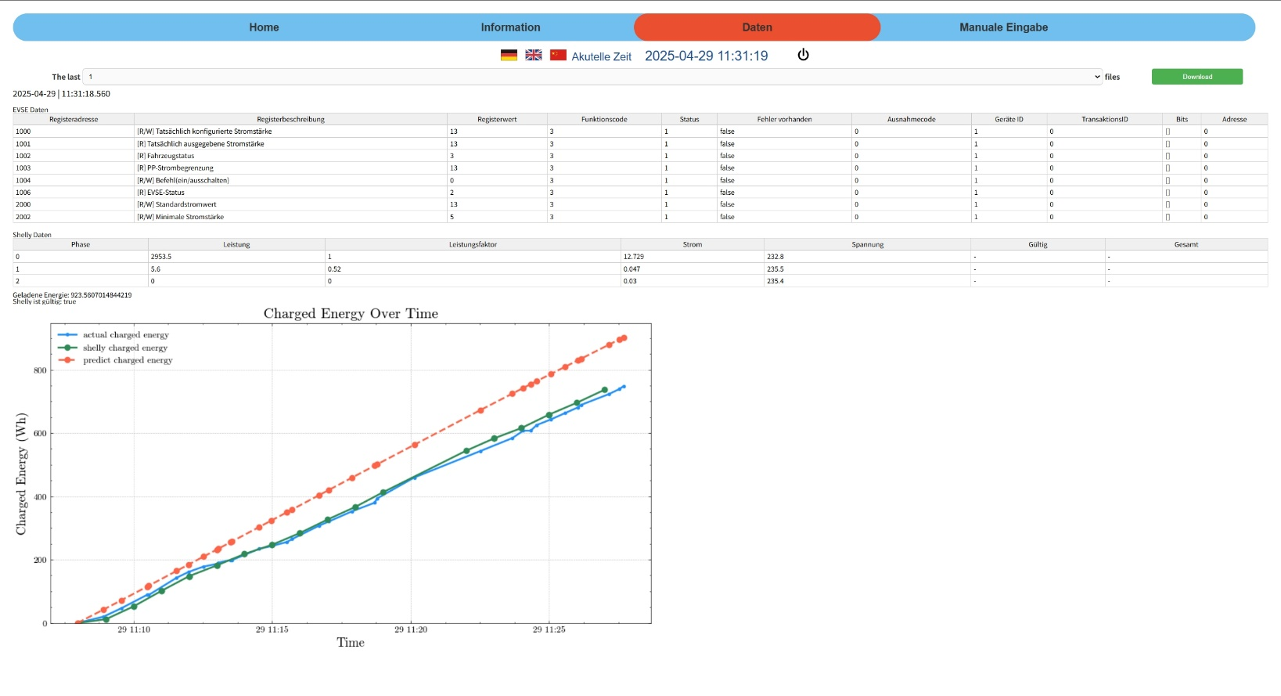
Conclusions
1, Results
1,1 Charging point control and optimization
3 modes: lowest-cost charging, shortest-time charging and dynamical charging
1,2 Data visualization
Figure 4: GUI

Slide 33
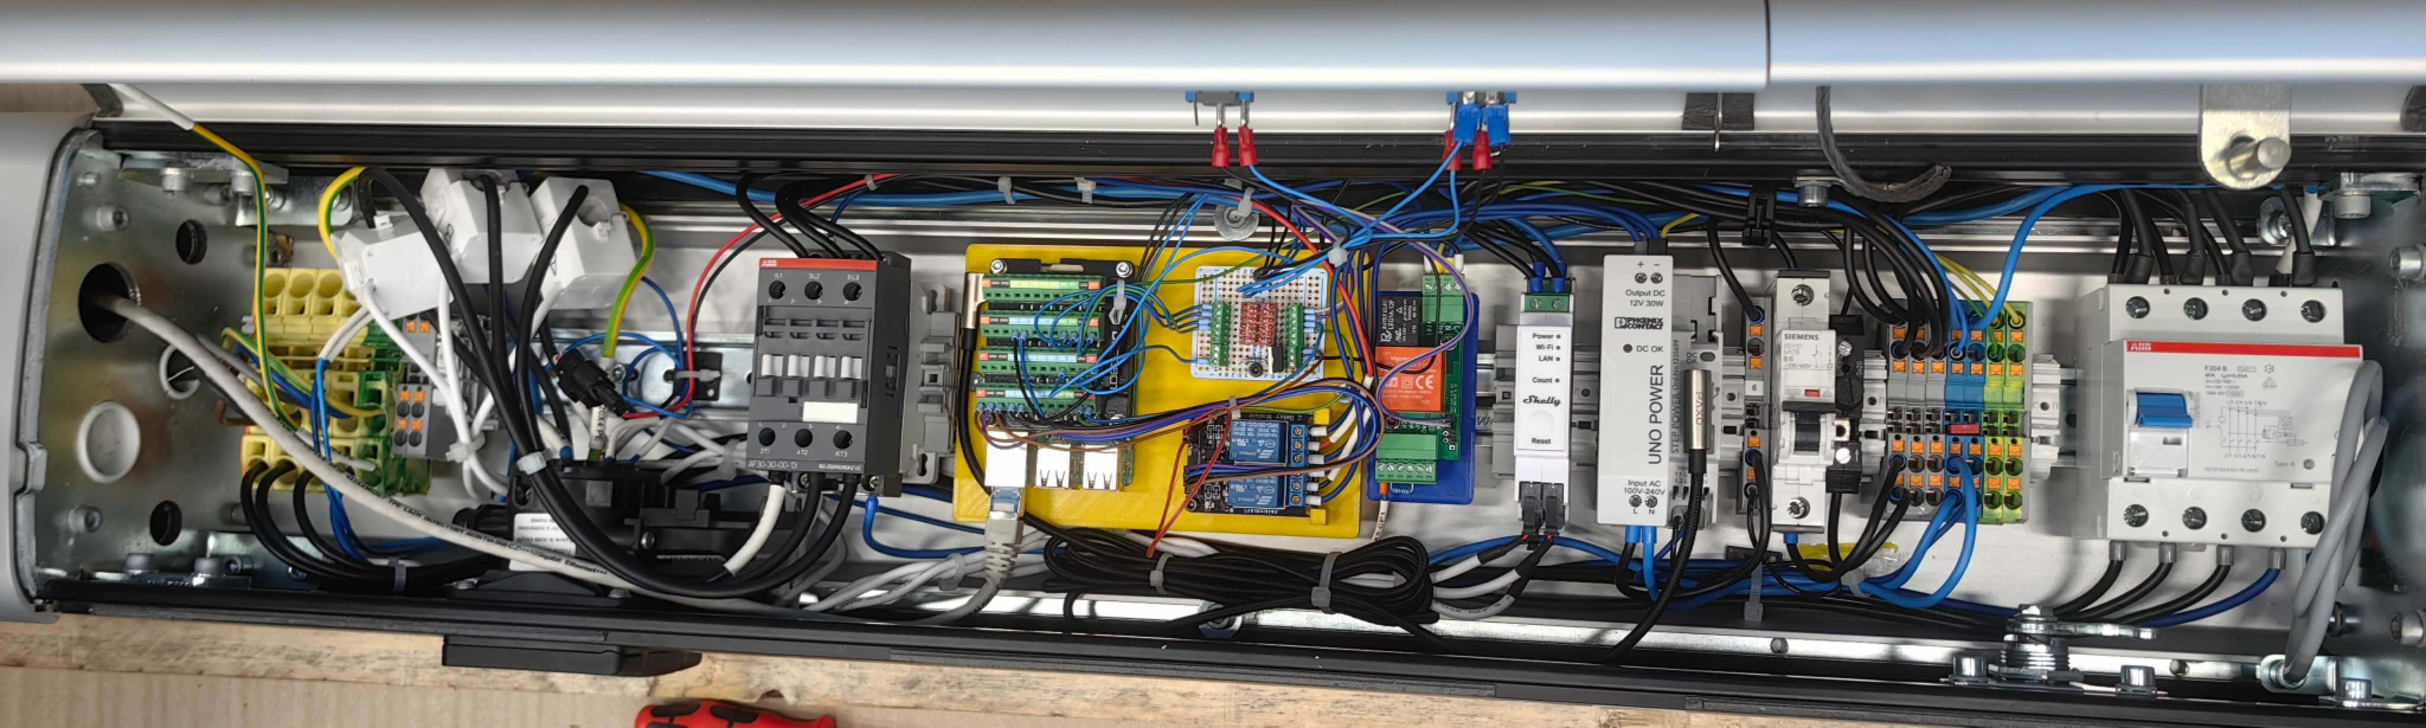
Conclusions
1,3 Communication between charge point and optimizer
1,4 GUI Deign including charging status, log information and control operations
1,5 Simulator Deign
1,6 Hardware modification (Raspberry Pi, Shelly, relay for DC-motor and LED-
indicator)
Figure 5: Hardware connection

Slide 34
Conclusions
2, Discussion
2,1 Compatibility Issues with the OCPP Python Library Versions
2,2 Current Monitoring and Safety Control
2,3 Raspberry Pi Wi-Fi Hotspot Support
2,4 Limitation on Web Terminal Message Display (memory overflow or browser crashes)

Slide 35
Literature
[1] https://www.statista.com/outlook/mmo/electric Electric Vehicles.url:vehicles/worldwide
(visited on 01/2025).
[2] International Renewable Energy Agency(IRENA). Innovation Outlook Smart Charging For Electric Vehicles.Tech. rep. International Renewable Energy Agency(IRENA), 2019

